Slide 1
Data Science Project plan
2021
A standard template which can be replicated for any project

Slide 2
Insurance Company - ABC
Jan 2021
Project context explained here -
An insurance company, has diverse set of insurance products, the business top level ELT team analyses the performance of the business via dashboards, one of KPI i.e. sales of health insurance was observed to be performing negatively. The sales of health insurance are going down from past few months.
Data Science Project

Slide 3
Project Plan
20XX
Data Science Project

Slide 4
1. Problem Definition
20XX
What is the problem you want to solve?
Which strategic goal is it linked to?
The company observed decrease in sales of health insurance -
Company has made huge investment in manpower, marketing and getting leads for health insurance enquiries
If the sales team can not handle all the enquiries, it leads to loss of business, loss of credibility,
The customers may shift to other competitors in the market, which may further lead to loss of market share.
It is observed that reason behind decrease in sales is more time taken by sales executives in handling one enquiry. The objective is to build an ML solution which can predict the value of annual premium for health insurance when provided with customer’s details.
Predictive model can help in decrease time taken to handle one enquiry which can boost the overall performance of sales team.

Slide 5
2. Data Definition
20XX
Customer churn rate
What specific output do you want to predict?
Customer churn probability -
Maximincto od essi sime voluptati ipis maximus. Liquatem voluptatur, con plabo. Ut que dUm quiae cus sus event velibus.
Rate conseris ma as dolupta idis aut apicide ruptatio.
Et expedis eossimpere mod mostinihil mo et.
Puditecte enimilluptae laboreri odi santotam as seque cor autem con restiistia volo.

Slide 6
2. Data Definition
20XX
What input data do you have for the algorithm?
Number of rows (roughly)
Number of years of history available
Location (where is it saved & how can it be accessed?)
How is the dataset generated & how frequently is it updated?
Are there any big changes / biases in the data?
Approx. 10000 rows
Each row representing a customer
From 2020 to 2022
Day wise data
Company central database
Sales database
Accounting database
CRM tools
Accounting ERP system
Sales ERP System
Possibly – geography wise bias

Slide 7
2. Data Definition
20XX
To be statistically analysed
Based on domain knowledge
Demographic patterns – Age, Gender, locality etc
Professional profile – job, education
What are the most relevant factors for predicting your specific output?

Slide 8
3. Performance Measurement
20XX
If yes:
How does it perform?
Do you have documentation on how it works?
(Explain about your approach of how will you measure performance of the model, if there is any method and benchmark
Do you have a simple benchmark to compare against?

Slide 9
3. Performance Measurement
20XX
It can be measure by comparing the predictions on test data with the real data on test data.
---------------------------------------
----------------------------------------------------- we expect minimum accuracy of 80%..
(Explain your answer with more details)
How will you measure the accuracy of the predictions?
What is the minimum level of accuracy you expect?

Slide 10
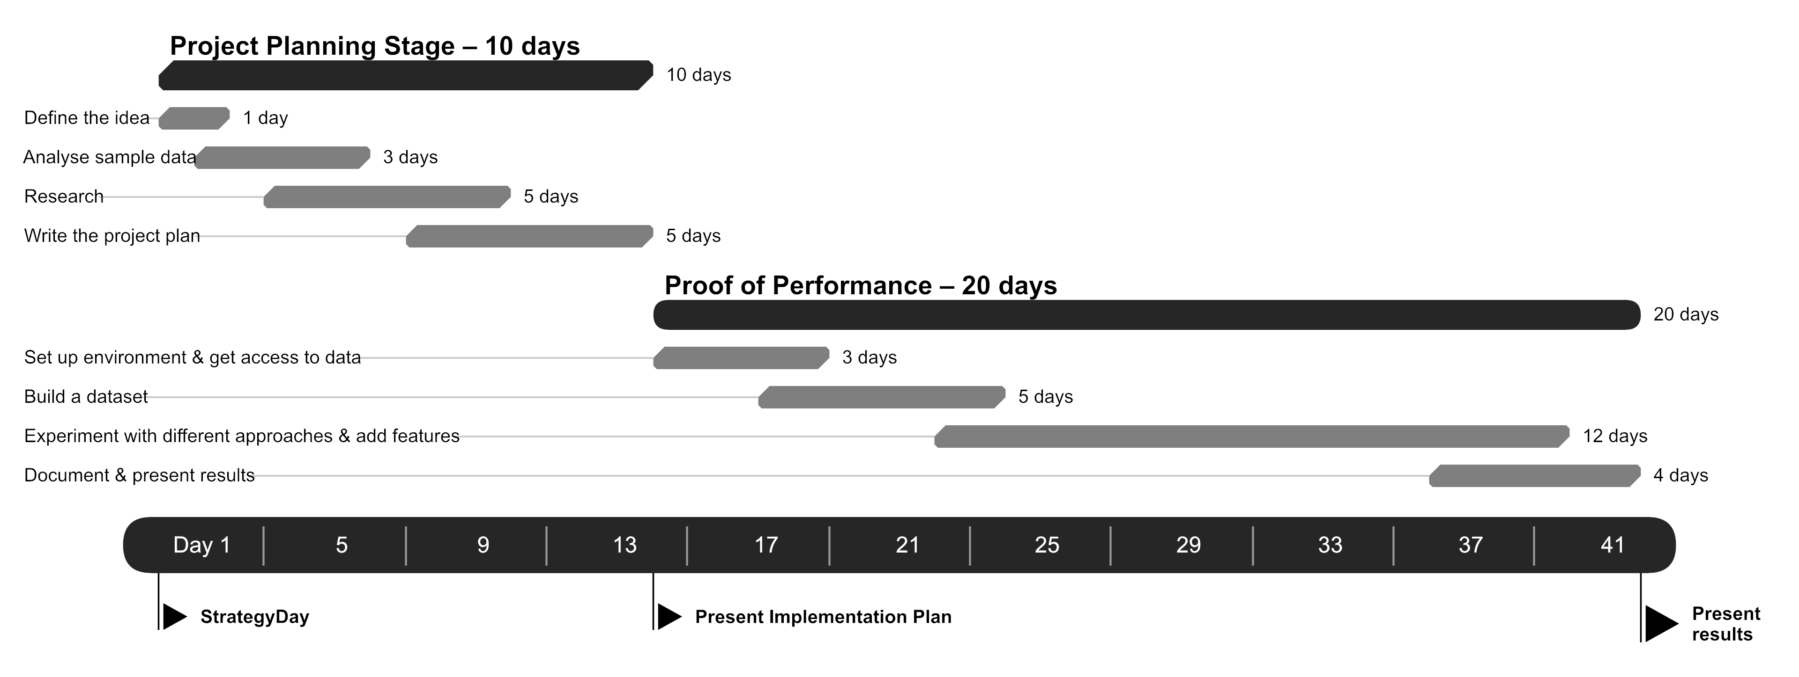
4. Timeline
20XX
Are there any deadlines to be aware of?
When do you need to see the first results?
When do you want to have a finished solution?

Slide 11
5. Contacts & Collaboration
20XX
Who is responsible for the project (PM)?
Who can grant access to the datasets?
Who can help understand the current process and / or the simple benchmark (domain expert)?
Define where code & issues are located and how to access them.

Slide 12
Project Execution
20XX
Data Science Project

Slide 13
Project process flow
20XX
Domain Exploration & Project Planning
Data Collection & Data Exploration
Data Cleaning
Feature Engineering
Preprocessing features
ML Modelling
Performance Analysis
Model Deployment
Optimization & Tuning

Slide 14
1. Domain Exploration & Project planning
20XX
Challenges | Actions | Outcome
Formulating the business goal with a technical problem Unclear understanding of how business process functions and which part to be optimized. Lack of understanding about data points which may be relevant to current use case | Connecting to business heads and leaders to understand the business goal Communicating with process owners to understand the business process flow, loopholes, factors impacting the process. | Fair understanding of business problem, goal to be optimized Clear idea of factors impacting the business KPI, data to be used for analytics Clear understanding of performance measure for the analytics solution

Slide 15
2. Data collection & Exploration
20XX
Challenges | Actions | Outcome
………………………………………………. ……………………………………………. | ………………………………………………. ……………………………………………. | ………………………………………………. …………………………………………….

Slide 16
3. Data cleaning
20XX
Challenges | Actions | Outcome
………………………………………………. ……………………………………………. | ………………………………………………. ……………………………………………. | ………………………………………………. …………………………………………….

Slide 17
4. Feature Engineering
20XX
Challenges | Actions | Outcome
………………………………………………. ……………………………………………. | ………………………………………………. ……………………………………………. | ………………………………………………. …………………………………………….

Slide 18
5. Pre-processing
20XX
Challenges | Actions | Outcome
………………………………………………. ……………………………………………. | ………………………………………………. ……………………………………………. | ………………………………………………. …………………………………………….

Slide 19
6. ML Modelling
20XX
Challenges | Actions | Outcome
………………………………………………. ……………………………………………. | ………………………………………………. ……………………………………………. | ………………………………………………. …………………………………………….

Slide 20
7. Performance Analysis
20XX
Challenges | Actions | Outcome
………………………………………………. ……………………………………………. | ………………………………………………. ……………………………………………. | ………………………………………………. …………………………………………….

Slide 21
7. Optimization & Tuning
20XX
Challenges | Actions | Outcome
………………………………………………. ……………………………………………. | ………………………………………………. ……………………………………………. | ………………………………………………. …………………………………………….

Slide 22
8. Model deployment/productization
20XX
Challenges | Actions | Outcome
………………………………………………. ……………………………………………. | ………………………………………………. ……………………………………………. | ………………………………………………. …………………………………………….

Slide 23






Project Overview
20XX
Item 1 Title
Item 2 Title
Item 3 Title
Maximincto od essi sime voluptati ipis maximus liquatem voluptatur.
Maximincto od essi sime voluptati ipis maximus liquatem voluptatur.
Maximincto od essi sime voluptati ipis maximus liquatem voluptatur.
Item 4 Title
Item 5 Title
Item 6 Title
Maximincto od essi sime voluptati ipis maximus liquatem voluptatur.
Maximincto od essi sime voluptati ipis maximus liquatem voluptatur.
Maximincto od essi sime voluptati ipis maximus liquatem voluptatur.

Slide 24
THANK YOU!
20XX
Anshu Pandey

